Slide 1
Introduction to Machine Learning

Slide 2
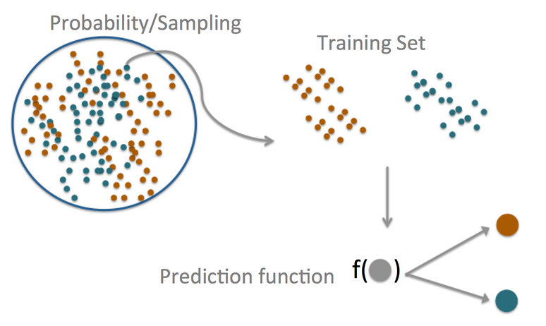
Introduction
Prediction can be understood to be the following things by different groups of people:
The central dogma of prediction
Prediction | Types of Statisticians
Statistical Learning | Statisticians
Machine Learning | Computer Scientists
Forecasting | Atmospheric scientists/Bankers
Artificial Intelligence | Members of the press

Slide 3
Machine Learning: Categories
Machine Learning basically can be classified into 2 categories:
Supervised Machine Learning: Learn to predict target values from labelled data
Classification: Target values are discrete values
Regression: Target values are continuous values
Unsupervised Machine Learning: Find structure in labeled data
Find groups of similar instances in the data (clustering)
Finding unusual patterns (outlier detection)

Slide 4














Supervised Learning: Classification Example
Future example
Training Set
X Sample | Y target value (Label)
Classifier
$$f:X→Y$$
$$x_{1}$$
$$y_{1}$$
Apple
f
f
$$x_{2}$$
Orange
$$y_{2}$$
At training time, the classifier uses labelled examples to learn rules for recognizing each fruit type.
$$x_{3}$$
$$y_{3}$$
Label : Orange
Apple
After training, at prediction time, the trained model is used to predict the fruit type for new instances using the learned rules
$$x_{4}$$
$$y_{4}$$
Lemon

Slide 5
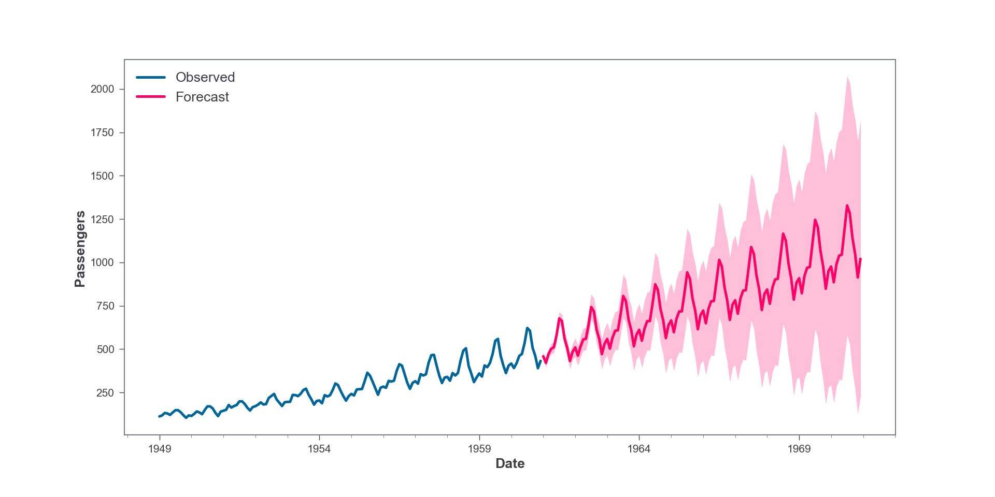
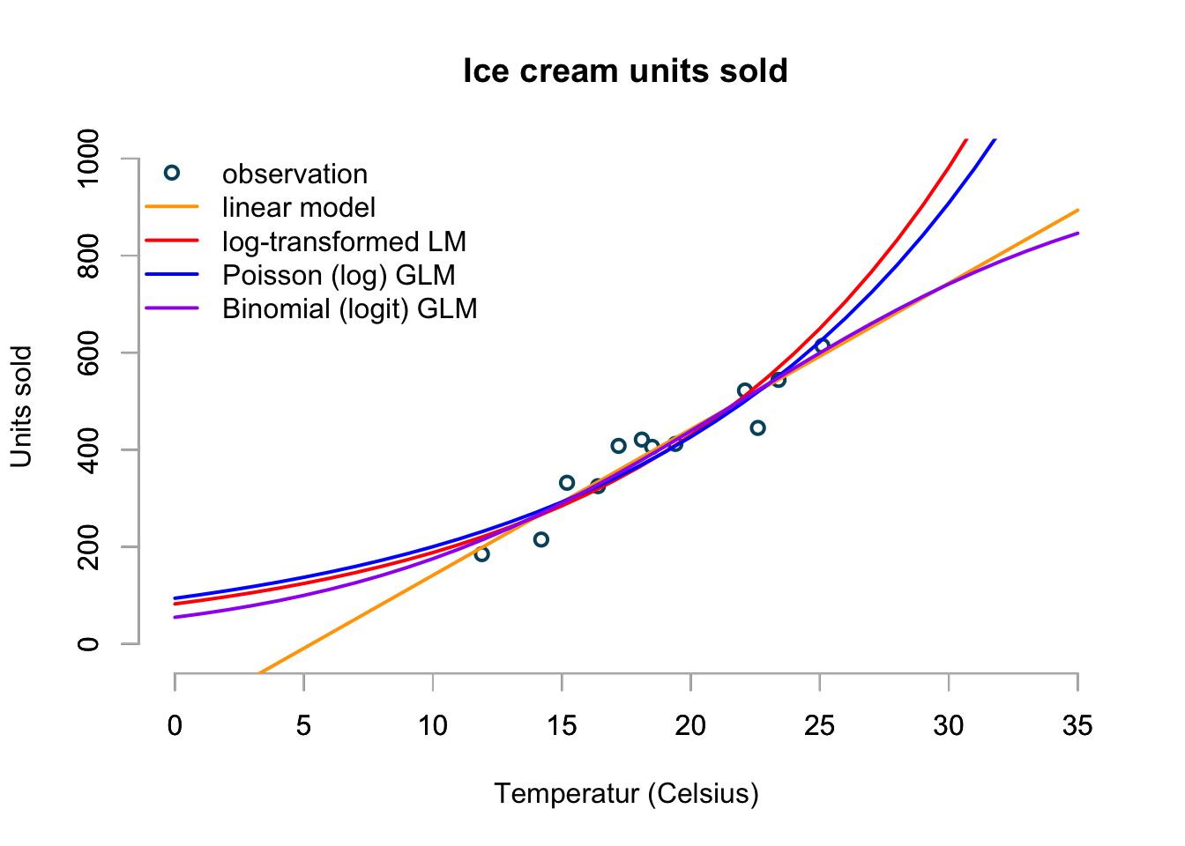
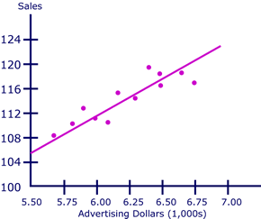
Supervised Learning: Regression Example
Time Series
Different Variable

Slide 6
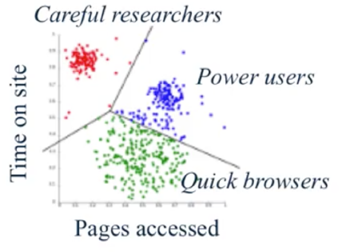
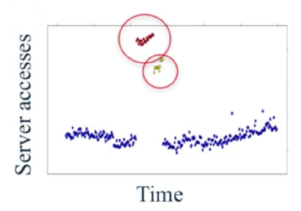
Unsupervised learning: finding useful structure or knowledge in data when no labels are available
Finding clusters of similar users (clustering)
Detecting abnormal server access patterns (unsupervised outlier detection)

Slide 7
Quiz
Which of the following are examples of supervised machine learning? Select all that apply.
Analyzing sales data to find groups of customers with similar buying habits
Making online movie recommendation based on the ”star” ratings that other users provided with their own online reviews
A face recognition system that trained using images with crowdsourced labels
A search engine that users user clicks on the results page to learn which pages are most relevant to popular queries

Slide 8

Quiz
Which of the following are examples of supervised machine learning? Select all that apply.
Analyzing sales data to find groups of customers with similar buying habits
Making online movie recommendation based on the ”star” ratings that other users provided with their own online reviews
A face recognition system that trained using images with crowdsourced labels
A search engine that users user clicks on the results page to learn which pages are most relevant to popular queries

Slide 9
Flow Chart of Predictive Modeling
Feature extraction
Normalization
Feature selection
Dimension reduction
Sampling
Model selection
Cross-validation
Metric
Hyperparameter optimization
Predicted Labels
Raw Data
Training Dataset
Learning Algorithm
New Data
Final Model
Labels
Testing Dataset
Labels
Pre-processing
Learning
Evaluation
Prediction

Slide 10
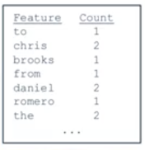
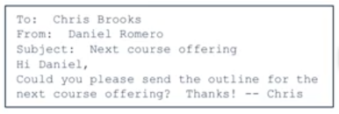


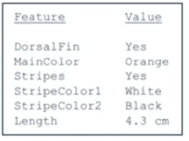

Feature Representations
Feature Representations
A list of words with their frequency counts
Email
A matrix of colour values (pixels)
Picture
A set of attribute values
Sea Creatures

Slide 11
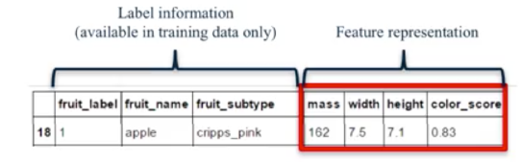
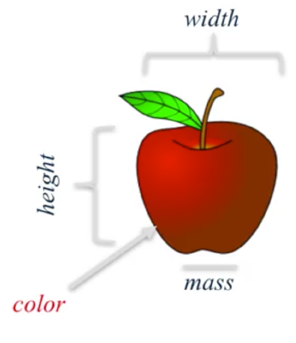
Representing a piece of fruits as an array of features (plus label information)
Feature Representations
Feature Representations
Classifier
Predicted Class (Apple)

Slide 12

Example: Classifying SPAM emails
Classic example of machine learning: SPAM emails classification

Slide 13
Summary of the SPAM example
Components | Elaboration
Question | Can I use quantitative attributes of the email to classify the email as belonging to the SPAM or non- SPAM group?
Input | Data Is the data perfect or sufficient? If not what do you do about it?
Features | In this context, can be a word count : in this example the count of the word ‘you’ is evaluated as a feature through
Algorithm | Here, a kernel density function of the frequency of the word ‘your’ in the email is used as the prediction function
Parameter | The cut-off point of 0.5 is used to differentiate spam emails from non-spam email
Evaluation | The prediction accuracy is measured in terms of percentage of correctly predicted labels

Slide 14
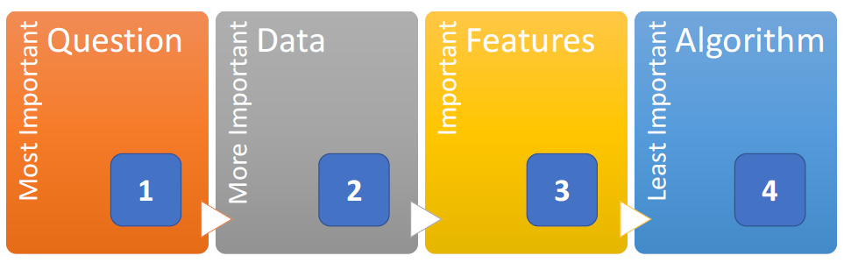
Which components are more important?

Slide 15
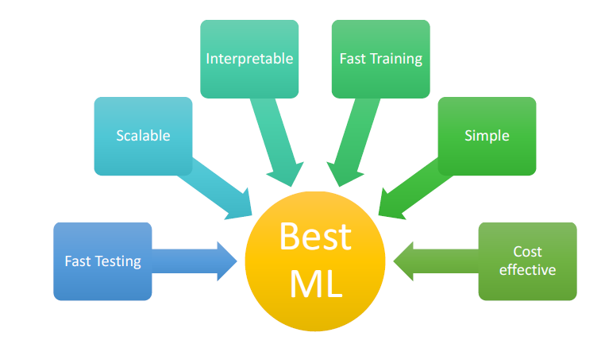
What is the “BEST” ML method then?

Slide 16
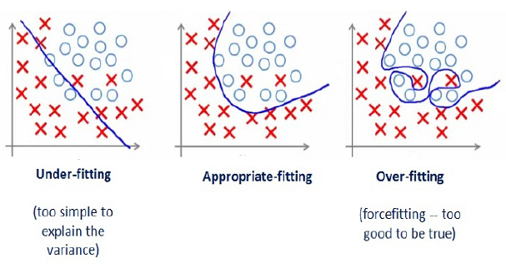
Generalization vs Overfitting vs Underfitting
Generalization – algorithm’s ability to give accurate predictions for new, previously unseen data
Overfitting - occurs when a model is excessively complex, such as having too many parameters relative to the number of observations. Overfitting describes random error or noise instead of underlying relationship
Underfitting - occurs when a statistical model or machine learning algorithm cannot capture the underlying trend of the data. It is when the model or the algorithm does not fit the data well enough

Slide 17
Common error measures for ML
Regression
R-squared: This is a measurement of how correlated your predicted values are with the actual observed values.
Mean Squared Error (or Root Mean Squared Error), MSE, RMSE. For continuous data, e.g time-series data
Median Absolute Deviation / Mean absolute percentage error, MAPE. Also for continuous data, more robust
Classification
Sensitivity (recall): if you want few missed positives
Recall, Specificity: if you want few negatives called positives
Accuracy: weights false positives/negatives equally
F1 (aka F-Score): The F score is the (harmonic) mean of both precision and recall.
Concordance: distance measures for multi-class data, example: kappa

Slide 18
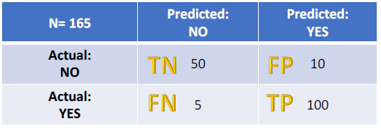
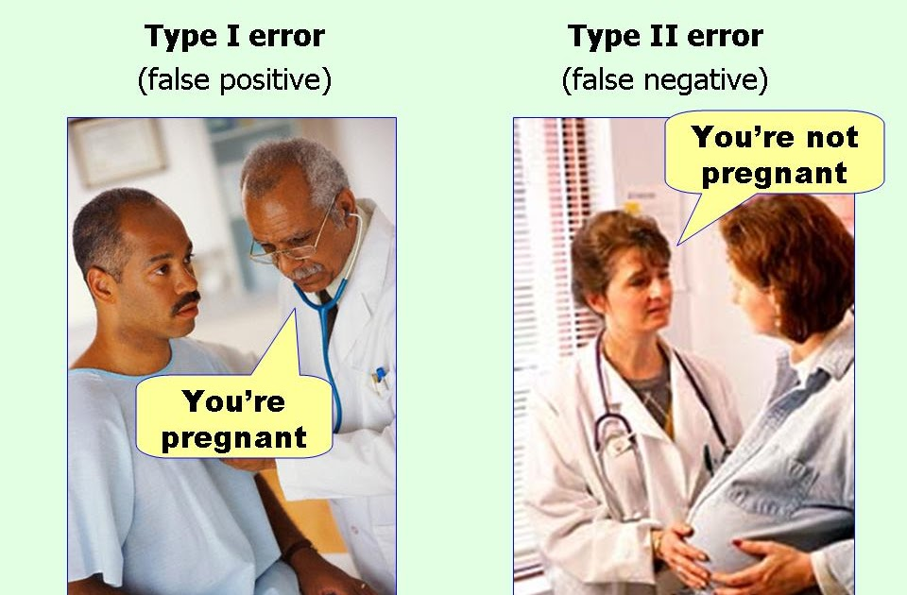
Some Error Measures From Confusion Matrix
Let's start with an example confusion matrix for a binary classifier (though it can easily be extended to the case of more than two classes): Here let’ consider prediction of diseases
Some Useful Terms
True Positives (TP): These are cases in which we predicted yes (they have the disease), and they do have the disease.
True Negatives (TN): We predicted no, and they don't have the disease.
False Positives (FP): We predicted yes, but they don't actually have the disease. (Also known as a "Type I error.")
False Negatives (FN): We predicted no, but they actually do have the disease. (Also known as a "Type II error.")

Slide 19
Other type of machine learning/projects
Market basket analysis (apriori, fp-growth algorithm): The objective of this data mining exercise is to identify if certain groups of items are usually purchased together.
Recommendation engine: Recommendation engines basically are data filtering tools that make use of algorithms and data to recommend the most relevant items to a particular user.
Stock Price Forecasting
Text Analytic
Text Clustering: Document clustering (or Text clustering) is automatic document organization, topic extraction and fast information retrieval or filtering.
Association Analysis: Association analysis is the method of identification of associations or relationships among entities and information in text. It determines how closely a word (term) is associated with other words or sentences
Sentiment Analysis: Sentiment analysis or opinion mining refers to the application of natural language processing, computational linguistics, and text analytics to identify and extract subjective information in source materials.

